Slide 1
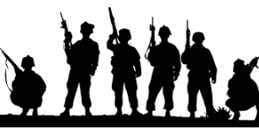
Immune System: Pathogens, External Barriers, Protective Reflexes
Ch 7 Human Perspectives – The Body can Protect Itself From Infection

Slide 2
Date: | Human Biology Year 12 ATAR
Do Now Get out your stuff, ready to start! Lesson Agenda 1: Do Now 2: Intro to Immune System 3: External barriers to disease entry 4: Review Worksheet Suggested Study Complete review worksheet, mark and correct using answer key on Connect. Read through today’s notes and textbook section NEXT LESSON Past Exam Question Non-specific defences | Learning Aims List several pathogenic bacteria and the diseases they cause Discuss the structure of bacterial cells List several pathogenic viruses and the diseases they cause Describe how viruses use cells to replicate Discuss modes of transmission of pathogens and give examples of diseases transmitted in each way List mechanisms the body uses to protect from pathogens List and describe external barriers to disease entry List and describe protective reflexes that assist in defence against disease Discuss behaviours and equipment that can assist the body’s external defences
 | Key Vocabulary Pathogenic Commensal Communicable Contagious Infectious Vector

Slide 3
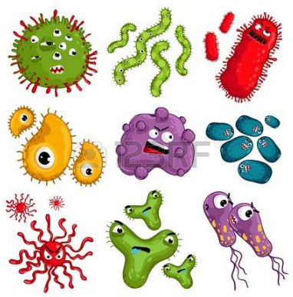
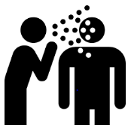
Vocabulary
Pathogens: disease causing organisms
Bacteria
Viruses
Protozoa, fungi, and others
Infectious disease: diseases caused by pathogens
Eg: A skin infection after injury is infectious, but doesn’t pass on to other people. Tetanus is infectious, and can be acquired from a penetrating skin injury as the bacteria lives in soil, but is not communicable. If you have tetanus, you can’t directly pass it on to anyone else.
Communicable/contagious disease: infectious disease that can be passed from one person to another
Eg: Covid-19 is infectious AND can be passed onto others.

Slide 4
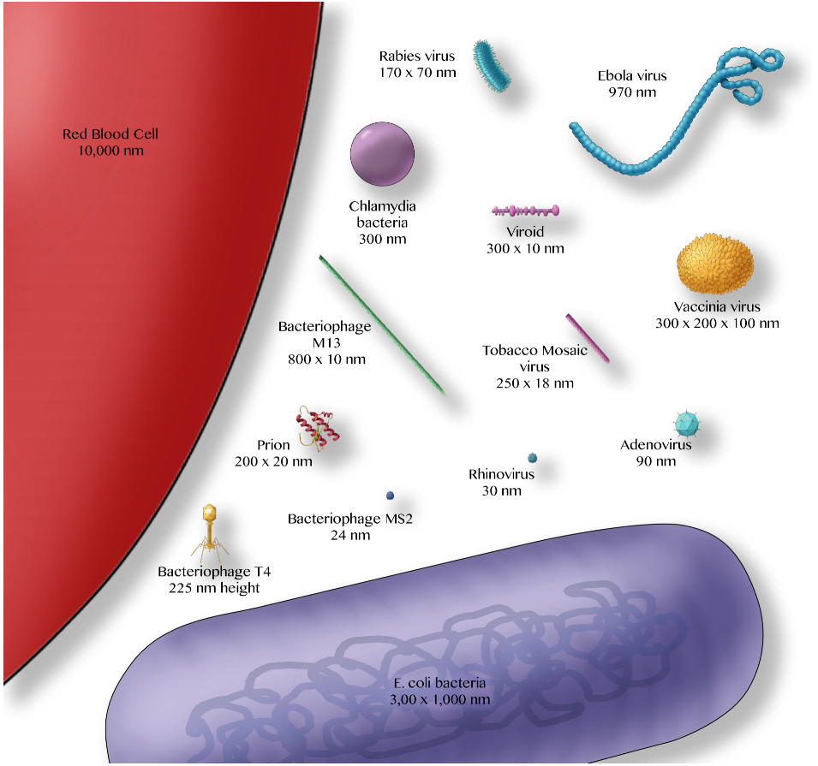
Relative Pathogen Sizes
Bacteria are much smaller than an average body cell, but can still be seen with a light microscope.
Viruses are much smaller again, and can be seen with a scanning electron microscope.
Size of pathogen can be a contributing factor to disease spread. Part of the reason that rhinovirus (which causes the common cold) spreads easily is because it is tiny and many particles can travel long distances via aerosol/droplet infection

Slide 5
Pathogen Types: Bacteria
Common/Well Known Bacterial Diseases
“Strep throat”, “ear infection” Streptococcus | Streptococcus is found naturally on skin but can infect already damaged tissue.
“Golden staph” Staphylococcus aureus | Staphylococcus is found naturally on skin but can infect already damaged tissue. Can be resistant to antibiotics.
Salmonella | Causes severe gastroenteritis
Tetanus Clostridium tetani | Causes severe, rigid paralysis and death. Vaccine and antitoxin available.
“Whooping Cough” Bordetella pertussis | Causes severe, prolonged coughing. Babies often die if infected. Vaccine available.
Syphilis Treponema pallidum | A sexually transmitted disease.
Tuberculosis Mycobacterium tuberculosis | Causes severe, difficult to treat lung disease, used to result in death. Now can be treated with long-term, powerful antibiotics. Vaccine available, so has been eradicated in some countries.
Most are harmless to humans
Commensal/non-pathogenic
Found everywhere including on skin, in gut
Some cause serious disease/death
These are called pathogenic bacteria
Single cell organisms
Can be seen using a light microscope
Very small
Some can be prevented via vaccination
Some can be treated with antibiotics
Learning Aim: List several pathogenic bacteria and the diseases they cause

Slide 6
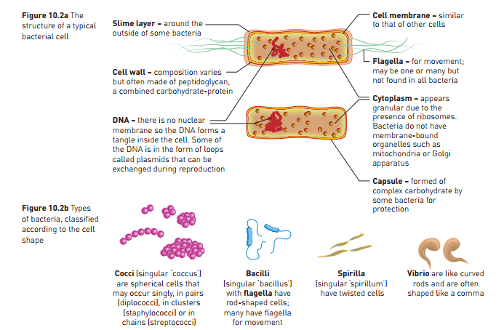
Bacterial Cell Structure
Learning Aim: Discuss the general structure of bacteria

Slide 7
Pathogen Types: Viruses
Common/Well Known Viral Diseases
Common Cold rhinovirus | Causes upper respiratory tract symptoms. Self limiting, mild. Supportive treatment
Flu Influenza virus | Causes fever and a range of other symptoms. Moderate to severe. Supportive treatment. Preventative vaccine available.
Covid-19 Coronavirus | Respiratory disease with high fatality rate. Prevention via hygiene, social distancing, masking, quarantine. Preventative vaccine becoming available.
Measles Measles virus | Causes rash, fever, gastrointestinal illness. Usually a disease of childhood. Now rare due to vaccination.
Mumps Mumps virus | Causes severe, painful inflammation of the salivary glands. Now rare due to vaccination
German Measles Rubella virus | Causes rash, fever and other symptoms. Can cause severe birth defects or death of foetus if caught by mother. Vaccine to prevent.
Chicken Pox Varicella virus | Itchy rash, fever and other symptoms. Usually a disease of childhood. Becoming rarer due to vaccination.
Polio Poliomyelitis virus | Severe paralytic disease causing permanent disability or death. Now extremely rare due to vaccination. Eradicated in many countries.
Warts Papilloma virus | Several types. Some types sexually transmitted. Genital warts can cause cervical cancer. Becoming rarer due to vaccine.
Very small – can only be seen with electron microscope.
Contain genetic materials eg DNA/RNA, surrounded by protein coat.
Enter cell and use their DNA/RNA to take over cell processes so virus can reproduce.
Not all viruses are harmful/pathogenic – some are even used in biotechnology!
Cannot be treated with antibiotics
Vaccines available for some deadly viral diseases
Learning Aim: List several pathogenic viruses and the diseases they cause

Slide 8
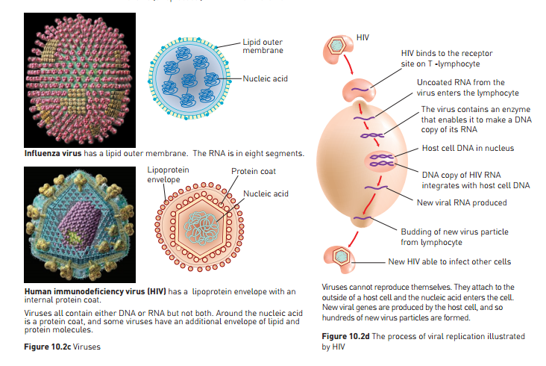
Example of how viruses use cells to replicate
Learning Aim: Describe the general structure of viruses and how they use cells to replicate.

Slide 9
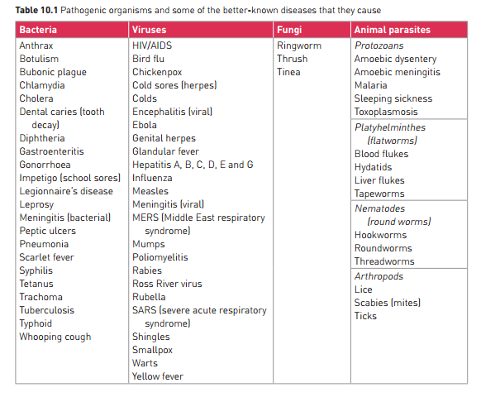
A range of other pathogenic diseases not already discussed.

Slide 10
Transmission of Pathogens
Different pathogens can be transmitted in different ways.
Contact:
Direct: by touching an affected person and the pathogen transfers directly eg. ringworm
Indirect: by touching something an affected person has touched eg. Catching cold virus from a phone used by someone with a cold.
Transfer of Body Fluids
Blood, semen, mucus, faeces, urine.
Affected person’s body fluids in contact with mucus membranes or bloodstream of another person. Eg: cold sores (a type of herpesvirus) are transmitted through salivary contact.
Droplet/Airborne Infection
Pathogens spread by coughing/sneezing as droplets of mucus containing the pathogens fly through the air and are inhaled or ingested. Eg. Colds, flu, COVID-19.
Ingestion
Infected matter is eaten or drunk
Eg. Salmonella food poisoning, cholera
Transmission by Vector
Vector = “carrier”
“vector” is another organism that carries the disease from one person to another
Eg. Anopheles mosquitoes are a vector for malaria
Rat fleas were a vector for Bubonic Plague
Note: some pathogens are very specific in how they are transmitted. Eg: malaria can only be transmitted via the Anopheles mosquito, but the common cold can be picked up from surfaces, via droplet infection, body fluids, or direct contact.
Learning Aim: Discuss modes of transmission of pathogens and give examples of diseases transmitted in each way

Slide 11
Defences Against Disease Overview
The body has many mechanisms to protect from invading organisms that cause disease:
External Barriers – prevent entry of pathogens
skin/membranes
Protective Reflexes – expel pathogens from body
Sneezing/coughing
Non-specific defences – general responses to a wide range of pathogens
Phagocytosis/Inflammation/Fever
Lymphatic System
Specific defences/ Immune Response – responses to specific diseases.
Antibody mediated immunity
Cell Mediated Immunity
Learning Aim: List mechanisms the body uses to protect from pathogens

Slide 12
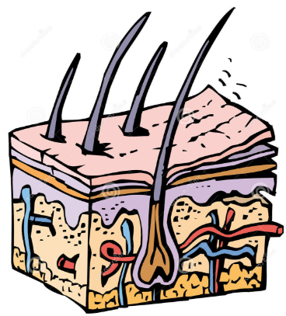
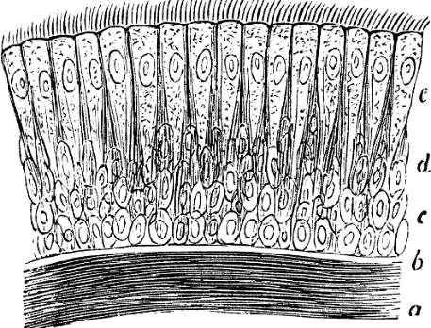
Defences Against Disease: External Barriers
Skin:
Effective barrier covering outside of body
Stops entry of microorganisms if unbroken
Normal bacteria also provide protection – stop pathogenic bacteria from settling in.
Secretes oily sebum – has substances that kill some bacteria
Sweat can also prevent micro-organism growth
Mucous Membranes
Eg in mouth, nose, conjunctiva, reproductive tract etc
Line body cavities that open to exterior
Secrete mucus – interferes with micro-organism entry
Hairs
In nasal cavity, ears, eyelashes
Trap pathogens for processing and removal
Cilia – tiny hairs with beating motion – sweeps mucus and pathogens towards entrance
Trachea
Nasal cavity
Other air passages
Learning Aim: List and describe external barriers to disease entry.

Slide 13
Defences Against Disease: External Barriers
Acids
Kill bacteria and other micro-organisms
Eg stomach acid, acidic vaginal secretions, sweat
Lysozyme
Enzyme that kills bacteria
Contained in tears, saliva, sweat, nasal secretions, tissue fluid
Cerumen
Ear wax
Slightly acidic, contains lysozyme
Protects ear canal from infection
Flushing action of body fluids
Helps keep free of pathogens
Learning Aim: List and describe external barriers to disease entry.

Slide 14
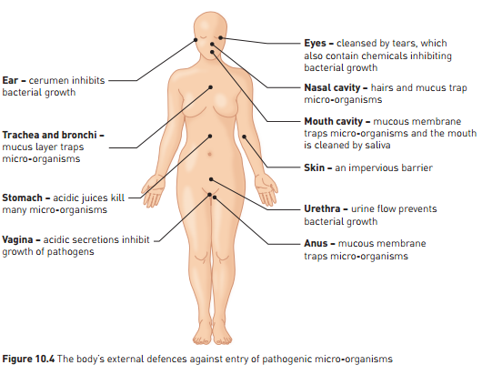
Defences Against Disease: External Barriers
Learning Aim: List and describe external barriers to disease entry.

Slide 15
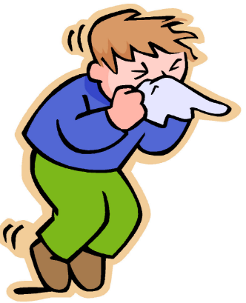
Defences Against Disease: Protective Reflexes
Sneezing:
Triggered by irritation of nasal cavity
Expels dust, dirt, mucus, and pathogens from mouth (not as much from the nose, despite what you think you know!)
Coughing:
Irritation of lower respiratory tract
Air forced from lungs, taking mucus and pathogens up trachea and out
Vomiting:
Contraction of muscles of abdomen and diaphragm
Expels pathogens from stomach
Diarrhoea:
Irritation of intestinal wall causes fluid to accumulate in intestines, plus explosive contractions of smooth muscle in intestinal wall.
Learning Aim: List and describe protective reflexes that assist in defence against disease.

Slide 16
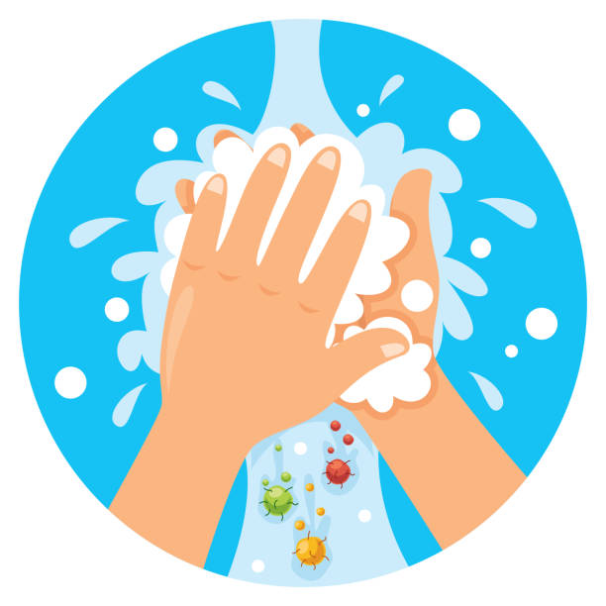
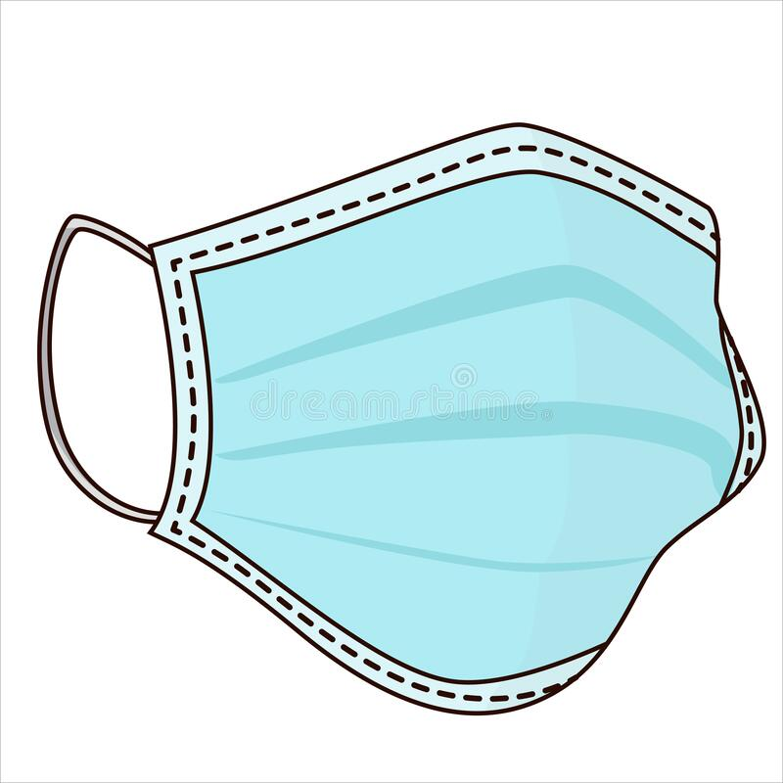
Assisting the Body’s External Defences
Disease can be prevented by assisting the body in preventing pathogen entry.
Examples include:
Wearing a mask to prevent spread of respiratory disease when you are sick
Maintaining environmental hygiene – wiping surfaces, regular cleaning
Wearing condoms to prevent sexually transmitted disease
Mosquito nets to prevent mosquito-borne diseases eg malaria
Frequent hand washing especially:
Before and after food preparation
After toilet
After using a tissue or touching nasal area or removing a mask
After coughing or sneezing
Sneezing and coughing into elbow.
Avoiding contact with people who are sick.
Self-isolating when unwell.
Learning Aim: Discuss behaviours and equipment that can assist the body’s external defences.

